Slide 1


A Machine Learning Approach for Aircraft Engine Fault Prediction
Capstone Project: EMBA Winter batch 24-26
Area of Interest: Decision Sciences
Mentor: Professor Shiv Shanker Singh Patel
2461034 Kaumudi deshkar
2461039 Madhava Rao Gadicherla
2461047 Mohit Kushwaha
2461056 Prabhala Srinivasa Vara Prasad
2461084 Satya Sai Kiran Kumar Dakavarapu

Slide 2
Problem & Context
Predict engine failures before they happen, so maintenance can be done just in time.
Root Analysis
Today's approach
Periodic maintenance is done at fixed time or flight-hour intervals to meet safety and aviation standards
But unplanned maintenance from component failures is costly, and it grounds the aircraft resulting to customer dissatisfaction
Our approach
Use multi-sensor (IOT) engine data and past failure records to detect failure patterns
Predict failures early so maintenance can be planned, cost-effective and timely
Keep aircraft flying more, which improves availability for customers
What we're building: A Machine Learning solution that warns of an upcoming failure early enough to plan maintenance
Why it matters:
  Higher aircraft availability for operators
  Less unplanned downtime
  Lower financial losses
Move from fixed-interval and unplanned maintenance to data-driven, condition-based maintenance

Slide 3
Brief about Aircraft Engine Data
Data is available
Modern engines have control and monitoring systems that record operational and health parameters throughout flight (Engine Fault Records)
This produces large volumes of telemetry data for tracking performance, spotting anomalies and supporting maintenance decisions
Data-driven health monitoring now complements traditional maintenance practices
Faults have many sources
Component degradation
Sensor failures
Actuator malfunctions
Control-system failures
Why early detection matters
Better operational reliability
Lower maintenance costs
Less unplanned aircraft downtime
ENGINE DATA RECORDS
CHIP 1
CLM_PERF
CRU_PERF
CONTROLLER_STATS
CONTOLLER_TIME_AT_TEMP
ENG_RED
ENG_STATS
ENG_PLA_T0
FAULT _RECORDS
IGNI_REC
A_LIFE
B_LIFE
INCI_REC_A
INC_REC_B
RLDW
STS
TAKEOFF_PERF
Root Analysis
Move from fixed-interval and unplanned maintenance to data-driven, condition-based maintenance

Slide 4
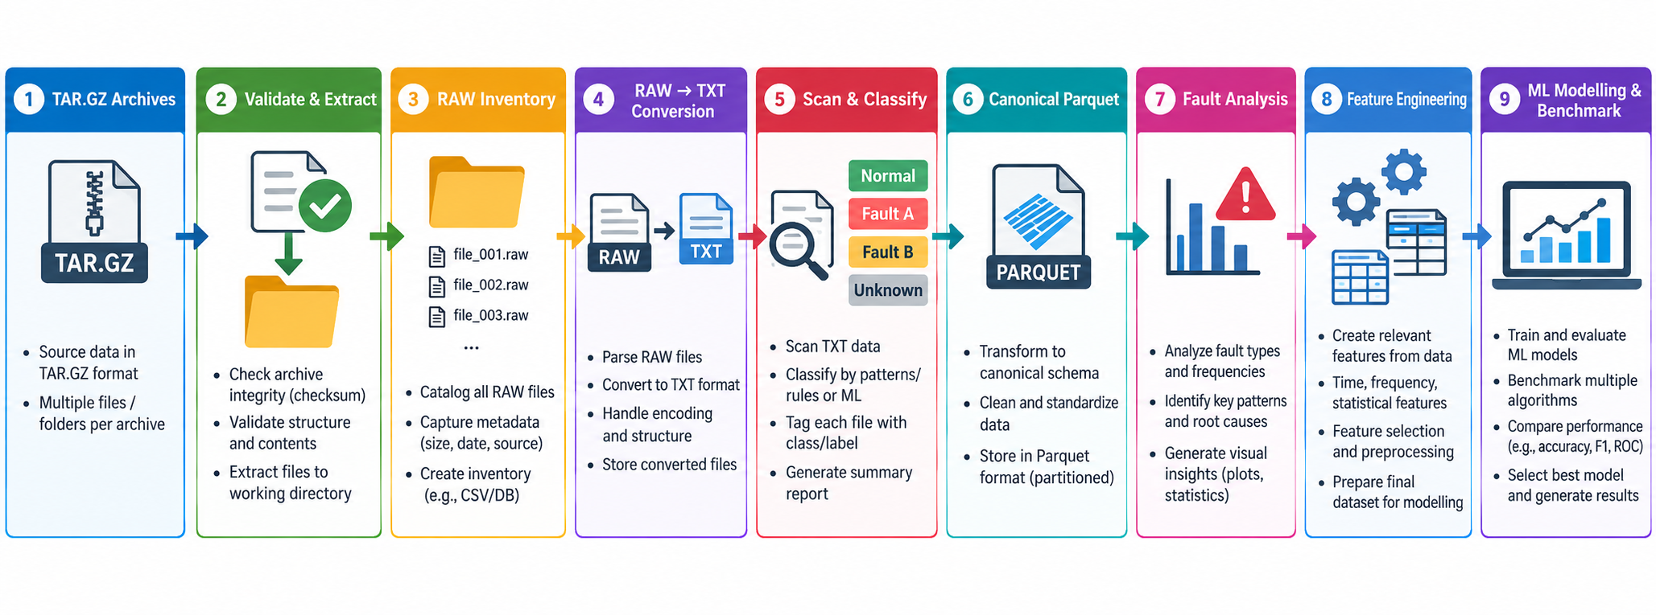
End-to-End Pipeline Overview
Root Analysis
Step Mapping | Task
1 To 3 | Data Acquisition and Organization
4 To 6 | Data Preprocessing
7 | Fault Analysis
8 | Feature Engineering
9 | ML Algorithms and Model benchmarking
Move from fixed-interval and unplanned maintenance to data-driven, condition-based maintenance

Slide 5

Acquire and Organize Data
1
2
3
4
5
6
7
Archive discovery
Identity recovery
Section parsing
Time extraction
Event union
Panel build
Modeling
ECFR TXT files
engine
incident + performance
GMT date + time
common long table
engine × snapshot
7D / 14D / 30D
tar.gz file is essentially a archive, The TAR/GZ format is used mainly for packaging and transferring a large number of files efficiently
After extraction tar.gz file, you get .RAW files, RAW = original source data
The RAW format apparently isn’t convenient for directly reading and processing the EFR information.
RAW TXT
EFR converter
The TXT representation exposes the information in a more structured, human/machine-readable form.
SHA-256 is used for data integrity and traceability.
Every Raw/TXT file we have a SHA-256 hash, because out of 1 lakh records, there is a chance that the records get duplicated:
Ex- Engine_001.RAW
↓
SHA-256
↓
A7F82C91.......
That long string is effectively a digital fingerprint or unique ID of the file’s contents.
If even a tiny part of the RAW file changes, the hash will normally be completely different.

Slide 6
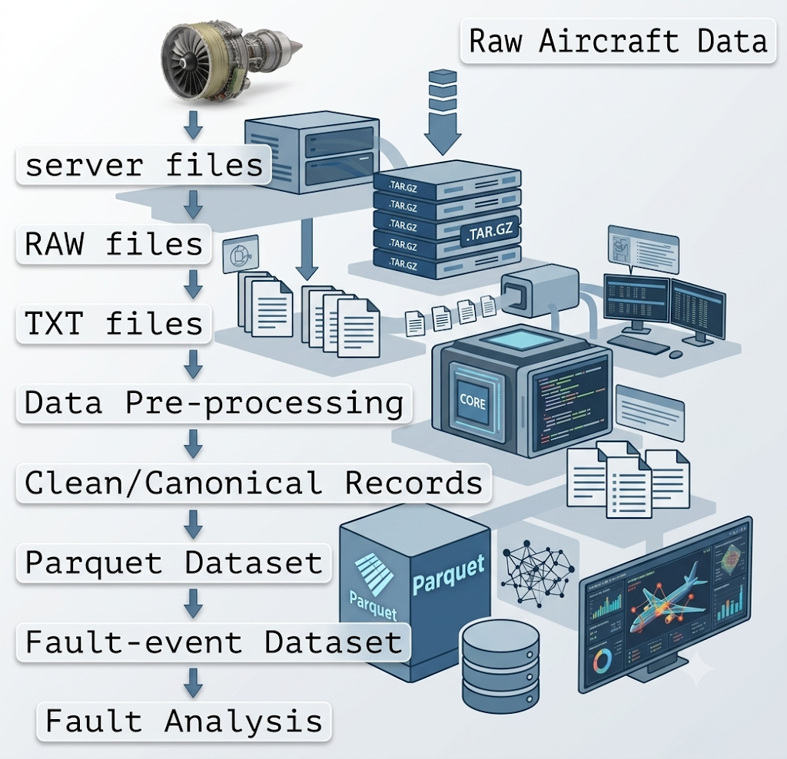
Identification of faults
export_fault_metrics_to_excel.py
After the aircraft-engine data has already been cleaned and stored in Parquet format.
It reads the processed aircraft-engine fault data from the Parquet file and examines the fault records one by one.
Purpose: Aggregates and analyzes engine fault occurrences.
Key Metrics:
  Groups data by fault code.
  Calculates fault frequency and percentage of total faults.
  Identifies unique affected engines and flight legs.
  Captures first and last observed timestamps.
The program also avoids loading the entire dataset into computer memory at once. It processes the data in batches called folds

Slide 7
Fault Analysis
Rank | Fault Code | What is the fault | Importance | Event Count | Affected Engines
1 | 111 | Local communication failure | Sequence of powerup can cause this fault, doesn’t mean actually there is a failure | 22866 | 1614
2 | 105 | Comms failure with air data | Sequence of powerup can cause this fault, doesn’t mean actually there is a failure | 10547 | 1167
3 | 61 | Cross Channel comms failure with air data | Sequence of powerup can cause this fault, doesn’t mean actually there is a failure | 9722 | 1136
4 | 110 | Bleed air status unavailable | Engine level power on sequence and shutdowns has an effect also indicates potential issues in bleed air flow, not enough physics based evidence | 7797 | 1021
5 | 175 | Insufficient rotation(point at which wheels leave the runway) data | Insufficient data points to make any judgement/ may not actually be a fault | 6899 | 914
6 | 176 | Cross side Insufficient rotation data | Insufficient data points to make any judgement/may not actually be a fault | 6779 | 886
7 | 206 | Failure of Thrust reversal system | The problem is genuine and worth solving, makes economic sense | 4490 | 918
8 | 108 | Loss of HP Bleed-Left | Not a standalone fault; this is only a early warning indicator | 3794 | 255
9 | 109 | Loss of HP Bleed-right | Not a standalone fault; this is only a early warning indicator | 3793 | 254
10 | 156 | ICU solenoid open when TR is not disabled | indicates solenoid fault/ power system failure; could be leading indicator of a TR system failure | 1999 | 514
Most of the top faults are noise
Fault 206 as the only fault flagged as "genuine and worth solving.
Genuine, physical failure mode. A thrust reverser fault is a real mechanical or hydraulic/electrical issue, so there is a true underlying signal to detect and predict.
Operational impact. The thrust reverser helps decelerate the aircraft on landing. A failure typically leads to maintenance action and hence costs involved.
Broad fleet spread. 918 engines are affected
Fault 156 (ICU solenoid open when TR is not disabled) is a leading indicator of TR failure. Its 1,999 events across 514 engines can serve as a precursor feature, giving the model something to predict from.

Slide 8
PHYSICS OF THE PROBLEM
TR functional chain: command to confirmed mechanical state
Deployment is a chain of hydraulic and electrical stages, each with its own status signal and its own timing.
1
2
3
4
5
6
Electrical
Command
Hydraulic energy
Mechanism
Aerodynamic effect
Feedback
Monitoring
TR Deploy request issued by crew
Pressure enables motion
Mechanical motion
Flow is redirected
Deploy switches, Position confirmed;
ECU compares state
Every stage of this sequence is a measurable timing event.
How long the reverser takes to move from command to locked-and-deployed is, in principle, a direct read on the mechanism’s health , the same way a slowing reflex is a symptom before it becomes a failure.
Normal behavior
Fault-observable behavior
The commanded state, physical position and feedback indication remain consistent.
Command/state disagreement can produce an ENGINE FAULT indication and maintenance conditions in the Engine controller download.
2
Notes:
[Sources]
- <Email>TR SSA</Email> identifies the electrical and hydraulic overview, PDA, command and indication circuits, deploy/stow switches, multiplexer, and ECU comparison behavior. citeturn5search96
[/Sources]

Slide 9
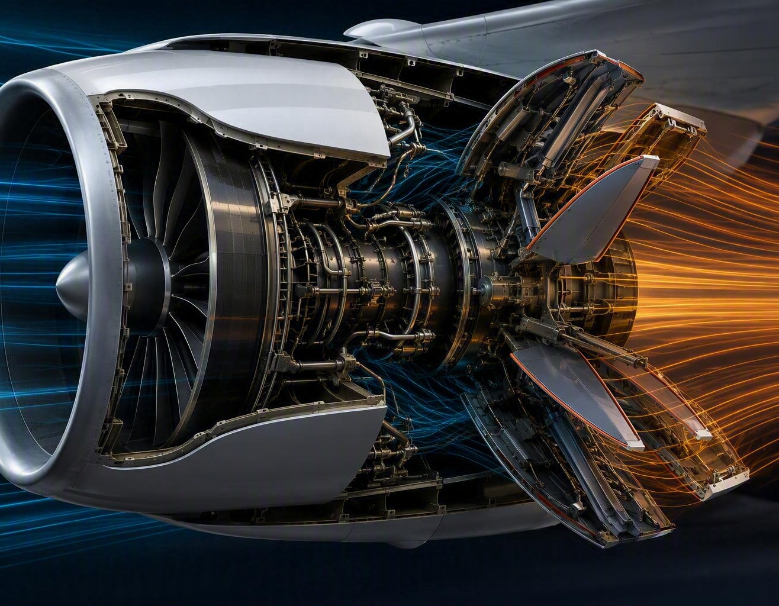
PHYSICS OF THE PROBLEM
Reverse thrust is momentum redirection, not “negative engine thrust”.
The nacelle converts bypass-flow momentum into a decelerating force after touchdown.
Momentum balance
F ≈ ṁ (Vout − Vin)
Mechanical wear doesn’t appear overnight.
Hydraulic pressure loss, actuator wear, and increased friction accumulate gradually (actuation sequence), these should be measured across a series of landings. It doesn’t fail outright or from a clean baseline with no warning.
This is the hypothesis the whole modeling program is built around:
a fault-in-progress should leave a signature in the trend of engine behavior across recent landings, not just in the reading at any single moment.

Slide 10
Data at a glance
98,635
1.67M
~2,000
9,300+
raw Engine Fault Records
partitions processed
engine landings in the
landing-level panel
engines in the
fleet-wide history
candidate features
per landing (V3.2)
The raw data is too large and too wide for convenient repeated CSV processing.
The pipeline therefore converts the information into Parquet partitions
Two variants for different models developed are used:
Top 500 features
Top 1000 features
The feature-ranking process ranks top 500 or 1000 candidates by means of Pearson correlation.
Absolute Pearson correlation between the feature and the Fault-206 target.

Slide 11
Model development & Feature Engineering
For every 30-day window, the code calculates things such as:
TOTAL_EVENTS_30D
Number of recorded events in the previous 30 days.
The code developed looks for fault 206 in Failure_RECORDS with a reliable
explicit GMT timestamp.
Then it asks:
“After this snapshot, does fault 206 occur within the next 14 days?”
If yes: FAILS_WITHIN_14D = 1
If no: FAILS_WITHIN_14D = 0
So, the ML problem is modelled as below:
Previous 30 days of engine behaviour
↓
ML model
↓
Will fault 206 occur within next 14 days?
OBS, ACTIVE, LAST, CHANGES
These are four ways of summarizing a parameter's recent history over the previous 30 days:
OBS → How many times did we receive a reading?
Example: Oil pressure was recorded 500 times.
ACTIVE → How often was the parameter active/non-zero?
Example: Oil-pressure abnormal condition occurred frequently.
LAST → What was the most recent value?
Example: The latest oil pressure was 50.
CHANGES → How often did the value/status change?
Example: If a status keeps switching ON/OFF, CHANGES will be high.

Slide 12
Comparison of approaches
Approach A
Approach B
Calendar-Anchored Snapshots
One row per engine, every 7 days, regardless of activity. Each row summarizes the trailing 30 days of behavior.
A 14-day forward-looking horizon (the target this program predicts against) converts a same-day emergency into a schedulable maintenance event
Landing-Anchored Windows
One row per physical landing. Features drawn from a short window right around that specific landing as TR only acts at landing.
One row = one engine landing
Features are extracted from a short window around each landing
The model uses the previous 30 days of engine behaviour to predict whether a fault will occur within the next 14 days
Engine-grouped validation reduces the risk of the model memorizing individual engines
The 14-Day Window
14 days of scheduling flexibility
Alert fires
Predicted
fault window
This is exactly why the program targets "fault within the next 14 days," not "fault right now": a same-day prediction has no economic value — there’s no time left to act on it.
The 7-day frequency is for creating prediction snapshots
8

Slide 13

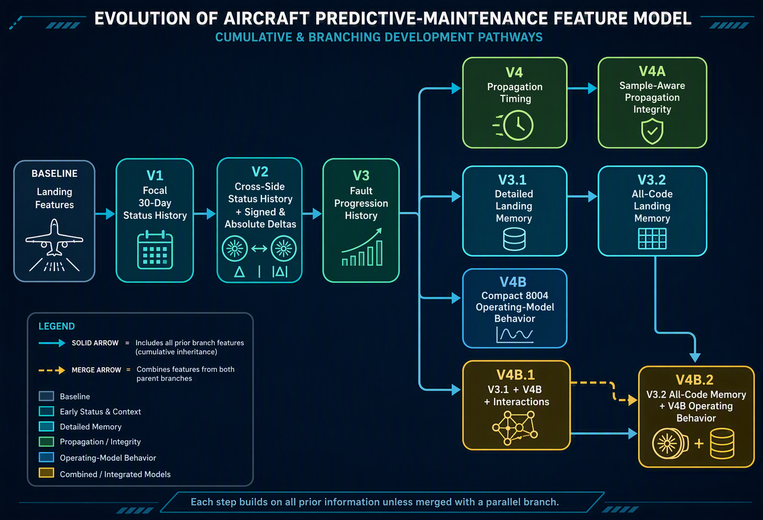
Project Roadmap
Version | Incremental code/feature change | What it adds
Baseline | Landing-level input features | Basic landing measurements and derived descriptors
V1 | Added 30-day focal-engine history | Previous status/fault behaviour of the same engine
V2 | Added cross-side engine information | Other engine on same aircraft + signed/absolute differences
V3 | Added fault-progression history | Recent fault occurrence/progression over time
V4 | Added propagation timing | Looks at command/response propagation behaviour

Slide 14
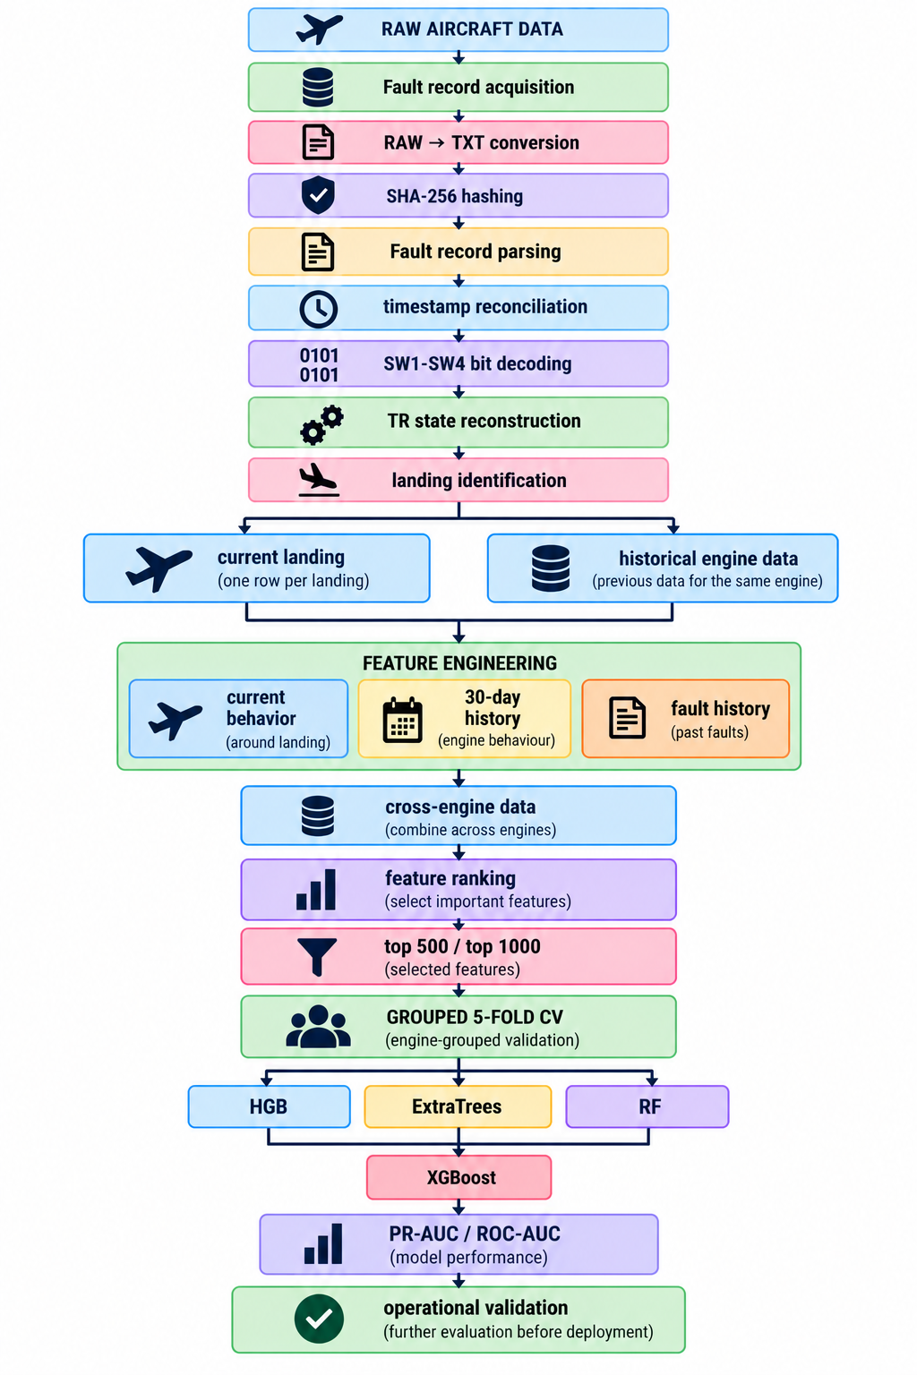
ML algorithms & End-to-End
architecture
Latest model compares six model families:
Histogram Gradient Boosting
Extra Trees
Random Forest
Elastic-Net Logistic Regression
SGD Logistic Regression
XGBoost
So the experiment is now:
28 feature variants (V1,V2,V3,V4 etc., with 500 and 1000 features
×
6 ML algorithms
=
168 model experiments
Each experiment uses: 5 validation folds
So there are effectively: 168 × 5 = 840 fold-level evaluations.

Slide 15
Variants with Incremental Progress
Each variant adds one feature family to its parent. Rows (1.67M landings), labels, aircraft-grouped folds, and learner stay matched.

Slide 16
Results
Strongest result we have obtained is
hybrid_v3_2_all_fault_landing_memory_ver05
hybrid_v3_2 feature ranking
Top 1000 with: Histogram Gradient Boosting
Another high-performing combination is:
hybrid_v4b_2_8004_all_fault_memory_ver04
Top 1000: XGBoost
with: ROC-AUC ≈ 0.734
and: PR-AUC ≈ 0.123
Metric | Result
ROC-AUC | 0.7446
PR-AUC | 0.1229
Prevalence | 5.25%
PR Lift | 2.34×
Features | 995
Records | 1,669,294
Landing-level data + historical fault/memory features + landing features + cross-side engine comparisons → feature ranking → 500/1000 selected features → six ML algorithms → grouped aircraft-level validation → predict Fault 206 within 14 days.
The strongest reported configuration is currently around ROC-AUC 0.745 and PR-AUC 0.123, with 1.67 million prediction records and 5.25% positive prevalence.
The expected output is a plain-language, actionable alert — exactly the form this needs to take to be useful to a maintenance planner:
“Tail N12345 — RIGHT engine shows a rising thrust reverser precursor signature over the last 5 landings. Recommend inspection within 14 days.”

Slide 17
Next Steps & Path Forward
Moving from Strategy to Action — Together
↑
↓
◎
▦
↻
Availability
Labor
Material
Inventory
Customer impact
Convert surprise removals into planned maintenance windows
Reduce manual search and shorten fault isolation
Replace the right component instead of broad troubleshooting
Stage spares against measured risk, not blanket assumptions
Reduce delays, cancellations and no-dispatch exposure

Slide 18
Current scenario: cost of unplanned maintenance by fleet scale
Failure-driven costs create material, labour, logistics and operational disruption exposure.
Cost component | Current cost / event | Calculation role
Direct material | $65,000 | Replacement parts after failure
Direct labour | $20,000 | Unplanned maintenance effort
Logistics & freight | $7,500 | Expedited movement of parts
Operational downtime | $40,000 | Unavailable operating time
Passenger & crew accommodation | $10,000 | Disruption-related support
Unplanned repair subtotal | $142,500 | Per failure event
Calculation item | 100 engines | 4,000 engines
Engines in scope | 100 | 4,000
Expected failures at 5% | 5 | 200
Unplanned repairs | 5 × $142,500 = $712,500 | 200 × $142,500 = $28,500,000
Periodic inspections / tests | $180,000 | $7,200,000
Total current annual cost | $892,500 | $35,700,000
Current Cost Estimates For Unplanned Repair Activities | App Estimated Cost in $
Periodic Inspections and Test per Engine | 20000
Aircraft grounding time and loss of availability cost | 25000
 | 45000
$35.7M
$712,500
annual unplanned repair cost
for 100 engines at 5% failures
CURRENT ANNUAL COST
FOR 4,000 ENGINES
5 failures × $142,500
200 expected failures annually
2
Notes:
[Sources]
Uploaded file: SAVINGS_PROJECTIONS_27 SEPT 2026.xlsx.
Visual on this slide was generated with Microsoft Copilot.
Periodic inspection cost of $180,000 per 100 engines is shown separately in the workbook projection.
[/Sources]

Slide 19

Expected savings with predictive planned maintenance
Early intervention reduces direct repair costs and removes the modelled disruption-cost categories.
Cost component | Current / event | Planned / event | Savings / event
Direct material | $65,000 | $35,000 | $30,000
Direct labour | $20,000 | $4,000 | $16,000
Logistics & freight | $7,500 | $2,000 | $5,500
Operational downtime | $40,000 | $0 | $40,000
Passenger & crew accommodation | $10,000 | $0 | $10,000
Total | $142,500 | $41,000 | $101,500
71.2%
cost reduction per repair event
$101,500 saved per event
Calculation item | 4,000 engines
Engines in scope | 4,000
Expected failures at 5% | 200
Planned repairs | 200 × $41,000 = $8,200,000
Periodic inspections / tests | $0
Total annual cost after model deployment to production | $8,200,000
Current Cost Estimates For Unplanned Repair Activities | App Estimated Cost in $
Periodic Inspections and Test per Engine | 0
Aircraft grounding time and loss of availability cost | 0
Total | 0
4
Notes:
[Sources]
Uploaded file: SAVINGS_PROJECTIONS_27 SEPT 2026.xlsx.
Visual on this slide was generated with Microsoft Copilot.
[/Sources]

Slide 20
Managerial implications for aircraft engines
Predictive maintenance changes the operating model, not only the cost base.
Maintenance strategy
Fleet availability
Shift from failure response to risk-based work planning; schedule interventions within available maintenance windows.
Reduce modelled downtime and accommodation costs; protect dispatch reliability and asset utilisation.
Parts & workforce
Governance control & Regulatory oversight
Pre-position material, avoid premium freight and align skilled labour with forecasted engine risk.
Track precision, recall, false alerts, avoided failures and realised savings; retain engineering sign-off. Approach to be approved by the regulator(DGCA/FAA)
Management action: validate the assumptions through a controlled pilot.
6
Notes:
[Sources]
Uploaded file: SAVINGS_PROJECTIONS_27 SEPT 2026.xlsx.
Visual on this slide was generated with Microsoft Copilot.
[/Sources]

Slide 21
Future scope of work
Maintenance actions is digitised
Integration of borescope inspection Video records
Engine logbooks are being digitised and will be fed to the model
Video records will be used for modelling for predicting the faults
Addition of High density data
LLM integration on the edge device
High Density data will be added to the model and it is expected to get ROC data up 0.8
Create actionable alerts after every landing
Note: Work underway for the above which have higher impact on engine maintenance philosophy.
6
Notes:
[Sources]
Uploaded file: SAVINGS_PROJECTIONS_27 SEPT 2026.xlsx.
Visual on this slide was generated with Microsoft Copilot.
[/Sources]

Slide 22
Thank you

Slide 23

The Strongest Natural Experiment Available- CROSS-ENGINE COMPARISON
Two engines on the same aircraft, at the same landing, share almost everything that could otherwise confound a comparison: runway condition, aircraft weight, atmosphere, pilot technique.
Same Aircraft, Same Landing
That leaves engine health as close to the only variable as real operational data gets — a far cleaner comparison than across different landings or different aircraft.
LEFT
ENGINE
RIGHT
ENGINE
Δ trailing-window features
Suppose an aircraft has:
Engine A = left engine
Engine B = right engine
and both engines are operating on the same aircraft during the same landing.
A large, sustained delta between sides — not just an absolute level on one side — is a strong, physically grounded fault signature.
“Is Engine A behaving differently from the other engine on the same aircraft?”
That can be a powerful predictive-maintenance signal.
Work in Progress- to be further explored
17

